Slide 1
Introduction to Git and GitHub

Slide 2
Session outline
Introduce Git and GitHub and explain the benefits of using them.
Explain the concepts underpinning Git and GitHub.
Demonstrate the basic Git and GitHub workflows using both the RStudio graphical interface and the command line.
Exercise
Mention some more advanced features that you are likely to come across.
Discuss good practice for effective collaboration.
Mention some security considerations when using GitHub.
Signpost additional resources.

Slide 3
Introduction
Git – version control system
Version control
Branching
GitHub – online platform for coding projects using Git
Online access
Collaboration
User interfaces
Graphical user interface (will cover RStudio)
Command line
GitHub

Slide 4
2. Overview of Git and GitHub concepts

Slide 5
Commits and branches
new_feature
new_feature
new_feature
Merge new_feature into main
main
main
1
2
3
main
main
Switch to a new branch
Notes:
We will start discussing the main Git concepts, starting with commits and branches. This will show
- how git works as a version control system, and
- what the development workflow looks like
Once you have initialized Git for a project, you will see a .git folder in your working directory. Git is now monitoring all the changes you make to the directory.
You can create some files, and whenever you want, you can tell Git to take a snapshot of their current status. A snapshot is called a commit.
We can represent a commit as a blob.
We’ll label the first commit as 1. (In reality, the ID is a long hexadecimal string called a hash.)
This first commit is a saved snapshot of all the files in our project at this initial point in time.
We can make some changes to the files and make a second commit. Now the project looks like version 2, but version 1 is saved in git and you could look at the files how they were in version 1, or stich back to it completely.
The ability to create commits, each containing a different state of your repository, and to switch between the commits, is what makes Git a version control system.
A project can go off on tangents, say to add new features. Each tangent is called a branch. By default, Git labels your initial branch "main". Technically, a branch itself is a label that points to one commit, but moves along as new commits are added to the chain it tracks.
If you want to work on a new feature. you can create a new branch. Here we create a new branch called new_feature. The new branch starts as just a new pointer to the current commit. But now if you add more commits, they will be added to the new_feature branch.
While you are working on your feature branch, you (or a colleague) might make changes to the main branch, so the branches will diverge - each branch contains changes that the other does not have.
Eventually, once your feature is complete, you can tell Git to merge it back into the main branch. Git handles this merge process so that the main branch then contains all the changes from both branches.

Slide 6
Commits and branches
new_feature
main
Notes:
As a result of the merge, the blue commits from the new_feature branch are now incorporated into the main branch. We can delete the feature branch without losing any work.
Git can handle most merges automatically, but if there are conflicting changes in the two branches you are merging, Git will require you to resolve the conflict manually.
Branches are a powerful feature of Git. An important benefit is they allow multiple people to work on separate features at the same time, each working on a separate branch. Git then handles the process of merging all the changes together (although some manual work might be needed if there are conflicts, for example where two branches both try to modify the same section of a file).
In the next slide we are going to illustrate how collaboration works using branches together with GitHub.

Slide 7
Collaborating using GitHub
GitHub remote repo
feature_1
“Pull request”
main
main
Kristina’s local copy of
the repo on the AP
“Push”
feature_2
“Push”
Ian’s local copy of
the repo on the AP
“Clone”
“Clone”
feature_1
main
main
main
feature_2
Notes:
GitHub is the web service that hosts the central, shared version of your project that everyone can replicate and work on, and contribute their changes to.
We are going to illustrate how collaborators on a project can work on their local copy of the repo and then send their changes to the shared GitHub repo.
We will illustrate how GitHub is used to combine the separate contributions together.
We start with a repo created on GitHub. (The AP guidance tells you how to create a repo). The repo has a couple of commits in it already.
Then Kristina wants to contribute to the repo. So she Clones the repo to make a copy of it in her Analytical Platform area (again following the AP guidance.)
Ian also wants to contribute so he does the same and clones the repo.
Kristina decides to add a feature. So she creates a branch called feature_1, so that her new feature will be isolated from the main branch until it is complete. Then she does some work to implement the new feature in a series of commits. When it is finished, she ”pushes” her new_feature branch to the remote GitHub repo and it appears there for everyone to see. Note that it doesn’t yet appear on Ian’s repo – he will need to use the “Pull” command at some point to update his local repo.
Now Ian decides to add a different feature, so he creates a branch, feature_2, branching off from a different commit on the "main" branch, and makes a series of commits until the feature is complete, and then he “pushes” the branch to GitHub.
Now the GitHub repo has all three branches as separate branches, and Kristina and Ian want their features to be merged into the “main” branch.
The way to do that is by creating a “Pull request” on GitHub. That creates a page on GitHub with features to discuss and review code, so other team members can review the code in each feature branch before it gets merged into main.
Kristina opens a pull request for the feature_1 branch. Once the review process is complete - typicallya team-mate reviews and approves the pull request - she merges it into main…

Slide 8
Collaborating using GitHub
GitHub remote repo
Merge
main
“Pull request”
Kristina’s local copy of
the repo on the AP
feature_2
Ian’s local copy of
the repo on the AP
feature_1
main
main
feature_2
Notes:
… Now main contains the commits that were in the feature_1 branch.
And because main contains those commits (shown in blue here), the feature_1 branch is no longer needed - and best practice is to delete it so we don’t have old branches hanging around in the repo.
Ian also opens a pull request for the feature_2 branch and that gets reviewed and then he merges it into main …

Slide 9
Collaborating using GitHub
GitHub remote repo
main
Merge
Kristina’s local copy of
the repo on the AP
Ian’s local copy of
the repo on the AP
“Pull”
“Pull”
feature_1
main
main
main
main
feature_2
Notes:
… so the “main” branch now contains the commits from both feature branches.
The last thing here is that both Kristina and Ian need to update their local copies of the main branch so that it contains the commits that have now been merged.
That is done using the “pull” command.
Kristina pulls from GitHub to update her repo, and so does Ian, and now their copies of the main are both up to date and they can start on their next contributions.

Slide 10
File states
Save
Working directory
Stage
Staging area
Commit
Commit history
The project directory in your file system containing your saved files.
Modified files marked to be added to the next commit.
Can be all modified files or a selection.
Files can be unstaged.
Stored commits - snapshots of the project.
Saved in the .git directory.
Notes:
Having looked at the big picture, we will now discuss the steps in making a commit.
There are three states a file can be in with git.
When you do a regular file save, the file is saved in your working directory as usual.
Git will notice if a file has changed and flag it.
If you want to add the change to a commit, you tell git to add the file to the “staging area”
You can add multiple files and changes to the staging area. You add files until you have added all the changes you want to bundle up into a commit. Typicallly, a commit will be a small, self-contained change to the code.
Once you have all the changes you want in the staging area, you make a commit. That adds your commit to the commit history, making it a saved snapshot in your project history, saved in the .git directory.

Slide 11


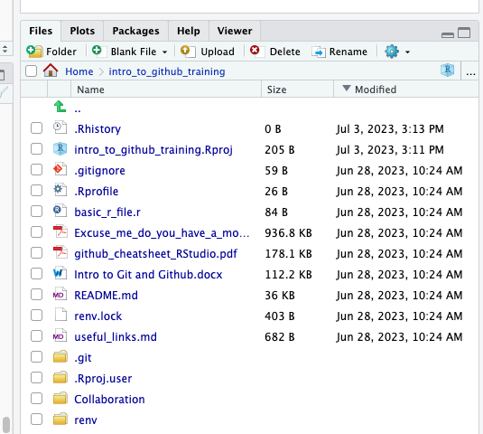
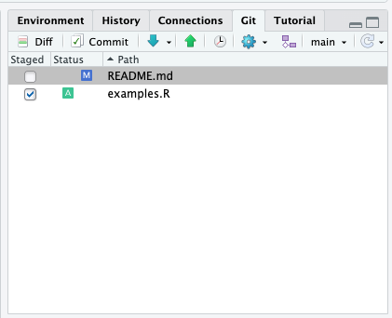
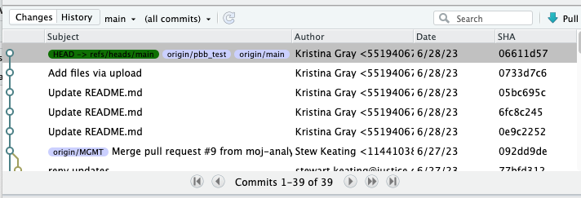
File states
Save
Working directory
Stage
Staging area
Commit
Commit history
?
Untracked file – a file that has not yet been staged or committed
M
Modified file
A
File added to the staging area
D
Deleted file
R
Renamed file
Notes:
View the working directory in the files pane
View the staging area in the git pane
View the commit history in the git history window

Slide 12
File states
git add
git commit
Save
Working directory
Stage
Staging area
Commit
Commit history
git status
git status
git log
Notes:
To view the state of the working directory and staging area: git status
To view the commit history: git log
To stage files: git add
To commit everything in the staging area: git commit

Slide 13
3. Walk-through of the basic Git workflow

Slide 14
Graphical user interface (GUI)

Slide 15
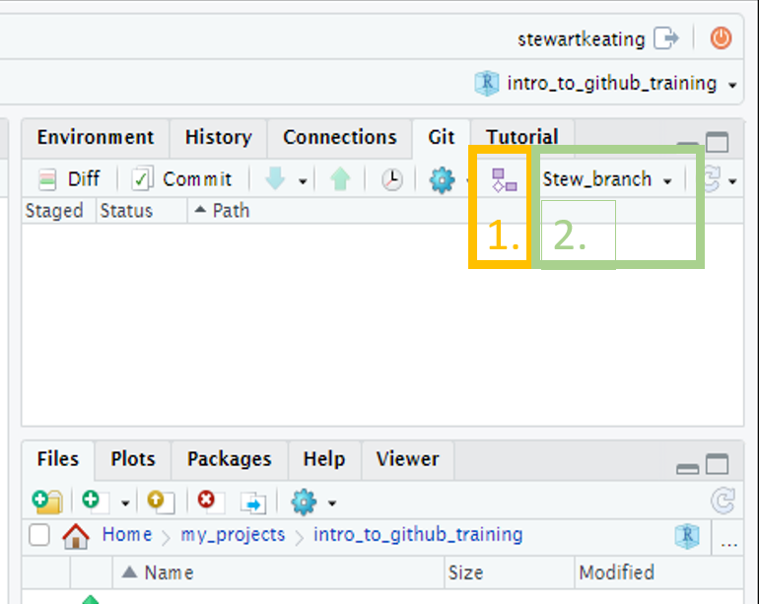
Create a branch
GUI
Create a branch: click the “Git” tab on the right of R-Studio, then the small purple shapes on the right of the screen, add a branch name, and click create.
A pop-up will appear with a message that you have switched to a new branch, and the branch name will update in the Git pane. You can just close the pop-up.
(Note that if the “Sync branch with remote” checkbox is ticked the branch will also be created on the remote GitHub repo, removing the need to do that manually at a later stage.)

Slide 16
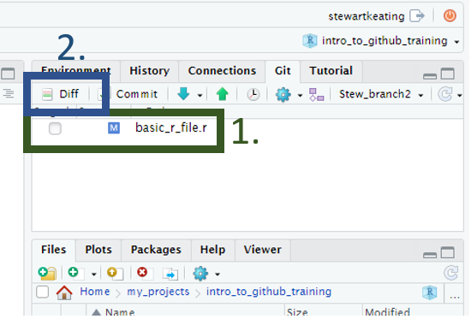
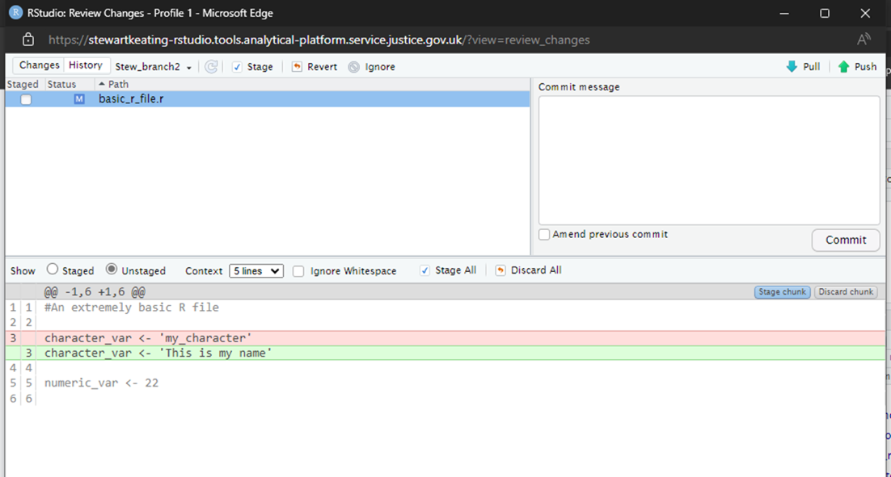
Edit some files, for example write some code to an R script
GUI
If using the GUI, any files that have been edited and saved will appear in the git tab on the right-hand side of the screen. You can view the changes by pressing the Diff button and selecting the file name. Lines highlighted in red have been removed; lines highlighted in green have been added. Lines written in grey have not been changed. The left margin shows the line numbers of the code that has changed.

Slide 17
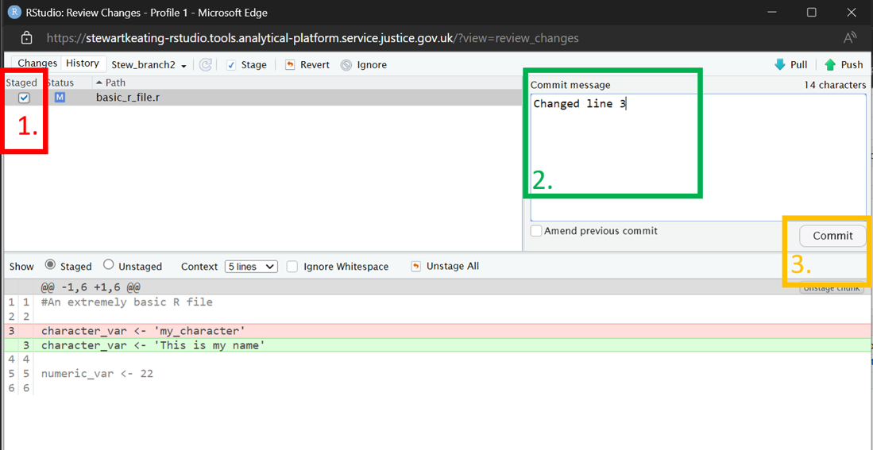
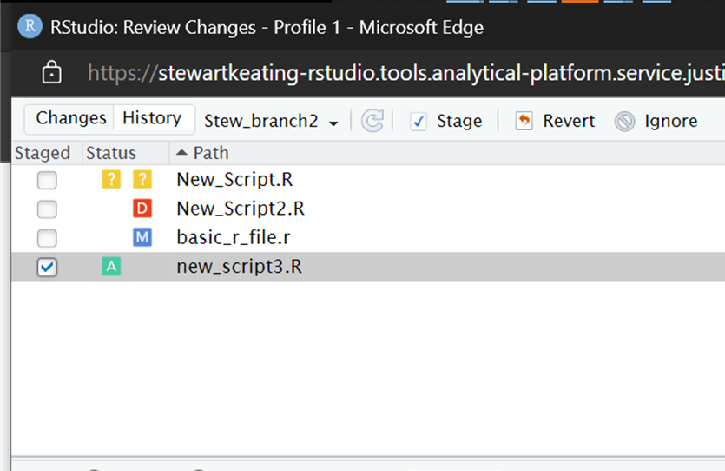
Stage and commit a group of changes
GUI
Click either Diff or Commit to open the Review changes pop-up.
To stage a file, click the check box by the file name. Stage every file whose changes you would like to include in the commit.
Add a commit message in the commit message box.
Click the Commit button.
Changes to files can be seen in the status column.
?
An untracked file – a file that has not yet been staged or committed.
M
A file that has been modified
A
A file that has been added to the staging area.
D
A file that has been deleted.
R
A file that has been renamed.
In this example, the previous line 3 has been replaced by a new line 3.

Slide 18
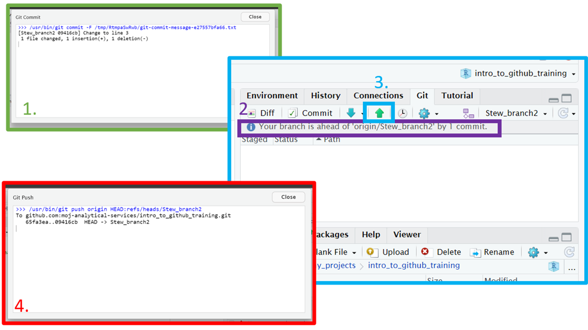
Push changes
GUI
After committing, you will see a pop-up listing any changes, additions, deletions and the commit message.
Back on the main RStudio screen, you can see how commits ahead of the remote GitHub repo you are.
To push your changes to GitHub, click the up arrow.
You will see another pop-up confirming your branch has been updated on GitHub.

Slide 19
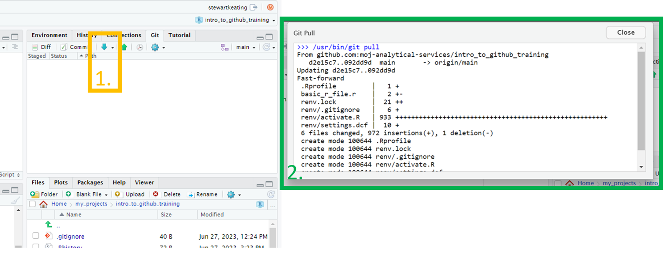
Pull changes into a local branch
GUI
After the merge has been accepted on GitHub, use the down arrow (next to the push arrow) to pull in the changes on GitHub.
A pop up will appear showing the changes.
In the GUI example screen shots, StewBranch2 was merged with Main branch. The local copy of Main Branch in R-Studio was updated by pulling the changes to Main Branch from GitHub.

Slide 20
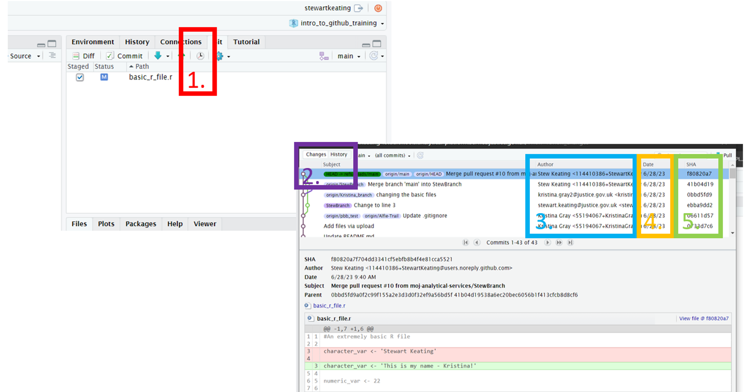
View the commit history
GUI
In the Rstudio Git pane, click on “History” to see the commit history for the current branch.
We can switch between the DIFF/COMMIT or HISTORY pop ups
3. The author of the commit
4. The date the commit took place
5. The unique ID for the commit

Slide 21
Terminal commands

Slide 22
Create a branch
Terminal
Use the git status command before you create a new branch. git status displays the current state of your files and the staging area: what branch you’re on and which files have been modified or staged since the last commit.
To create a new branch:
git checkout –b my_branch

Slide 23
Edit some files, for example write some code to an R script
Terminal
In the terminal, git status displays the current state of your files and the staging area.
You can also use the git diff command to show changes. Typing the command without any options shows the uncommitted changes since the last commit.

Slide 24
Stage and commit a group of changes
Terminal
Use git add to add files to the staging area.
To stage a single file:
git add my_file.txt
To stage all modified files:
git add .
Use git commit to commit the staged files.
To commit the staged files and open a text editor in which to type the commit message:
git commit
To commit your changes and type an inline commit message (instead of opening the text editor):
git commit -m "My commit message"

Slide 25
Push changes
Terminal
Use git push to push your branch to the remote repo.
To push to a branch that already exists on the remote repo:
git push
If your branch does not yet exist on the remote GitHub repo, the first time you push you will need to create a remote version:
git push –u origin my_branch
The option -u is a shortcut for --set-upstream, which creates a version of the branch on the remote repo.

Slide 26
Pull changes into a local branch
Terminal
If you are not currently on the main branch, switch to it with:
git checkout main
Use the git pull command to merge commits added to the remote branch into your local branch.

Slide 27
View the commit history
Terminal
The git log command shows the commit history for the current branch, starting with the most recent. The --oneline option is useful to condense the output. You can limit the number of commits shown with the – option.
For example, to see the most recent five commits on the current branch :
git log --oneline -5

Slide 28
Practice
1. Clone the course repository and create a new branch
If you have not done so already, clone the course repo by following the steps in the set-up section at the start of this document.
Create a branch with any name you choose.
2. Create and edit a file and commit the changes
Create a new folder within ‘practice_folder’ and then create a new R script within the folder. Write something in the R script. Press ‘save’ to save the script.
Add the changes to the ‘staging area’ and then commit them. Add a commit message that briefly describes the changes you have made.
3. Push the changes to Github
Now that you have committed your changes to the local version of your new branch, push the updated branch to the remote Github repo.
4. Open a pull request on GitHub and merge
Navigate to the GitHub repo and open a pull request to merge your branch into main.
Merge the branch using the option at the bottom of the pull request page.
5. Pull the updated version of the main branch into your local version of the repo
In RStudio, switch to the main branch. Look in the file pane and note that files you made in your new branch are not shown. You might get a dialogue box asking you if you want to close open files that are not in the main branch.
Pull changes from GitHub and notice that the file pane updates to include files from the new branch.
Check the commit history to see that your commits are now part of the main branch.

Slide 29
4. Advanced topics

Slide 30
Resetting changes
Terminal
To reset the staging area (also to undo commits)
git reset
To amend the previous commit by adding new staged changes
git commit --amend
To make a commit that reverses a previous commit
git revert

Slide 31

Merge conflicts
The code between <<<<<<< and ======= is the current branch
The code between ======= and >>>>>>> is the code in the branch that is being merged in
To resolve:
Edit the code to contain the final version
Delete the conflict markers (<<<<<<<, =======, >>>>>>>)
Stage the file and commit

Slide 32
Stashing changes
Terminal
To temporarily store your work without making a commit
git stash

Slide 33
5. Effective collaboration

Slide 34
Good practice
Make small and self-contained commits
Clear commit messages
Small branches and regular merges
Pull request descriptions
Branch protection rules
Delete merged branches
Document your repository

Slide 35
6. Security considerations

Slide 36
Good practice
Repository visibility
Storing data
Git ignore files

